Slide 1

Github guide
Tyler yam

Slide 2

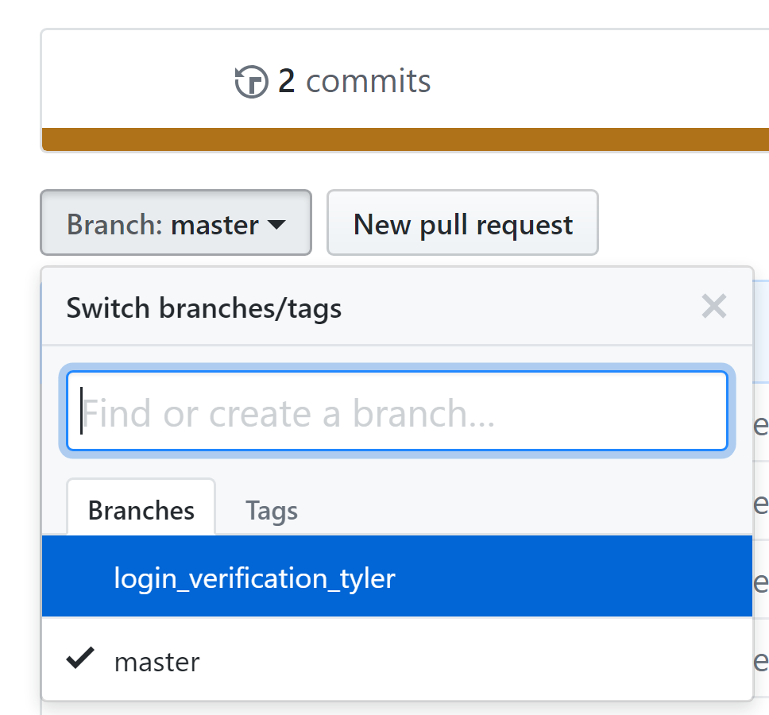
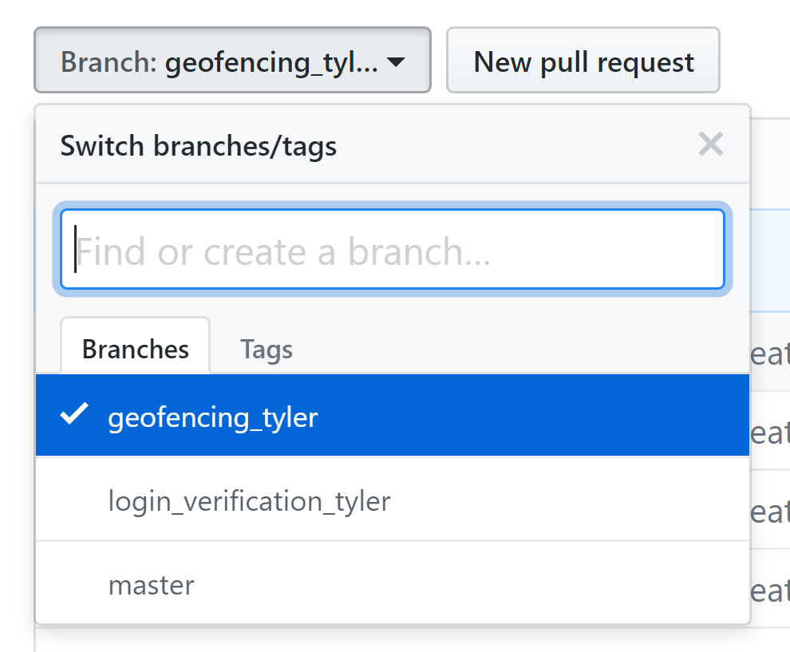
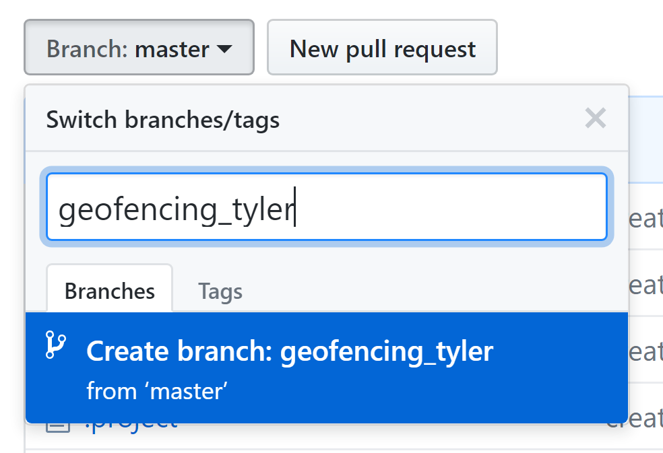
Creating a new Branch

Slide 3
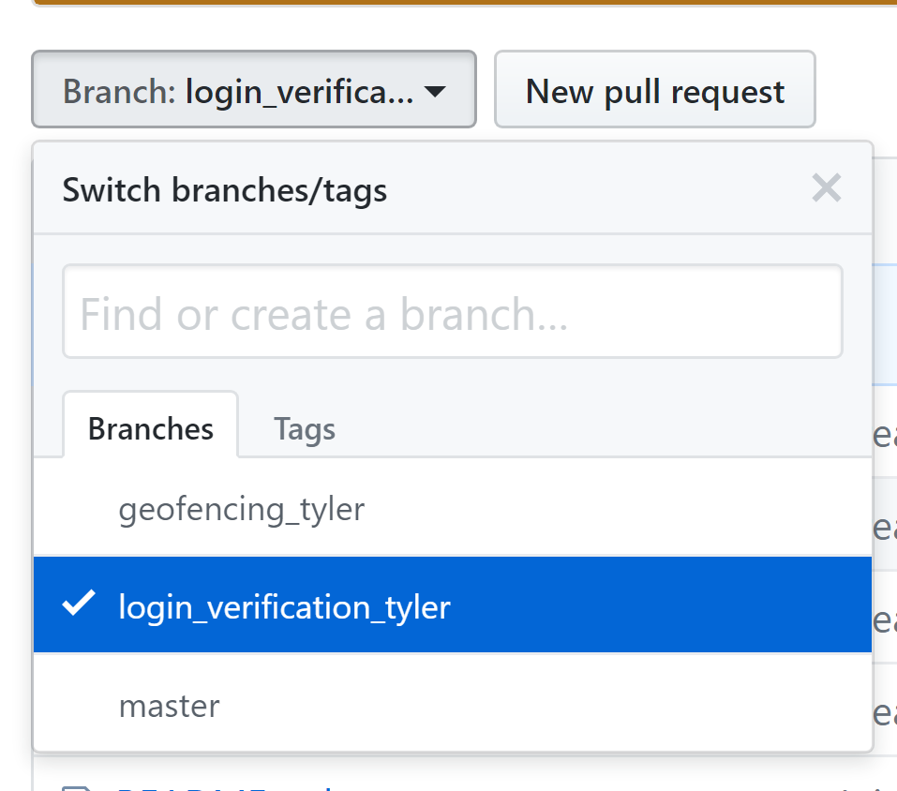
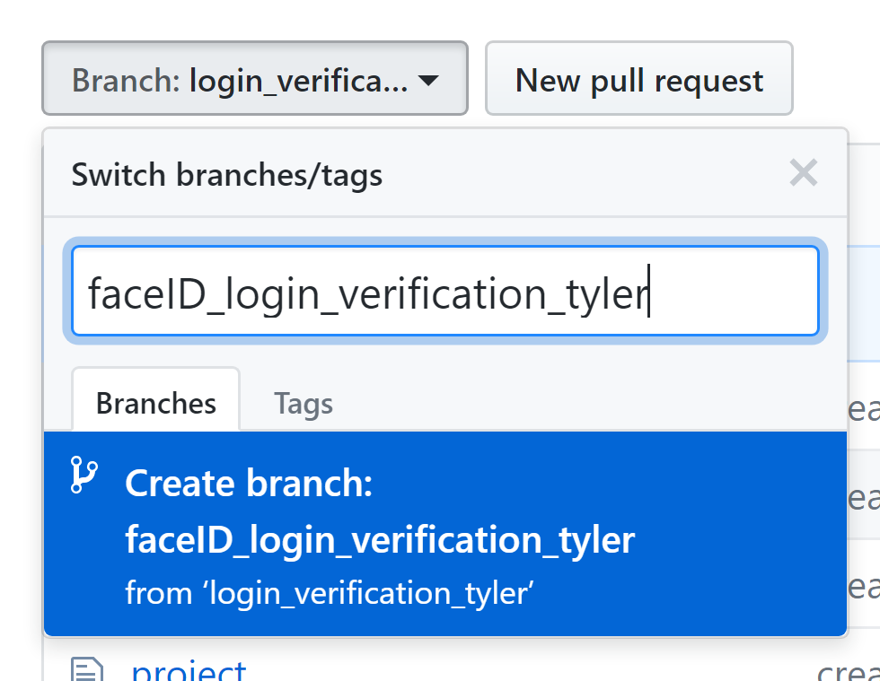
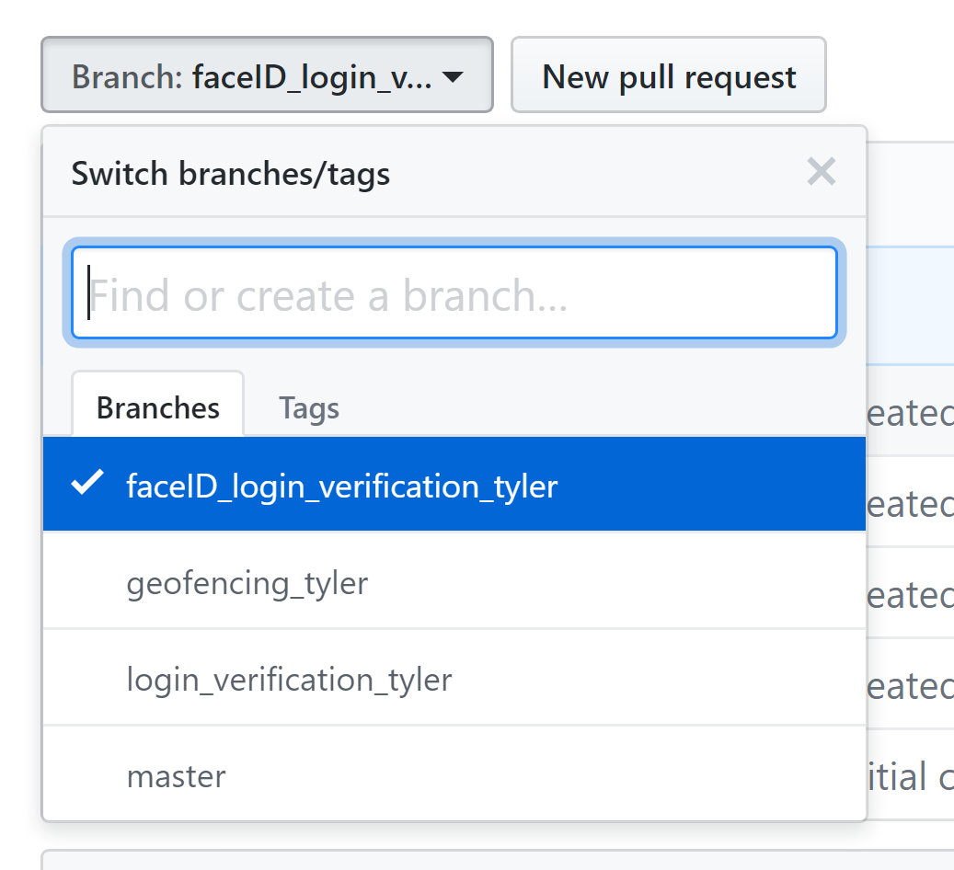
Creating a new branch

Slide 4
Accessing that Branch
git pull
git checkout <branch name>
Work on that branch
git add sample.swift
git commit –m “Taught some youngings github”
git push

Slide 5
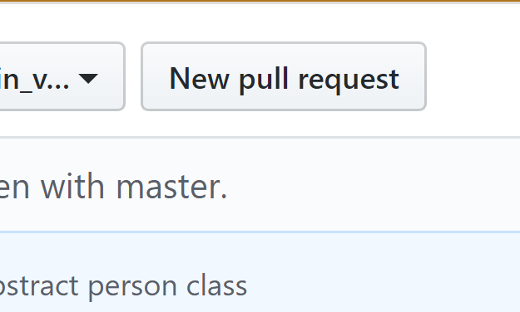
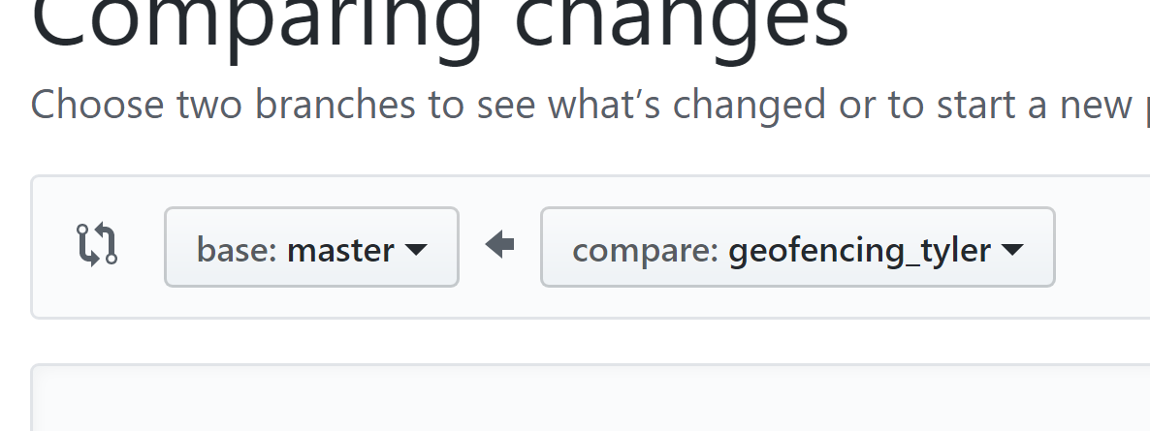
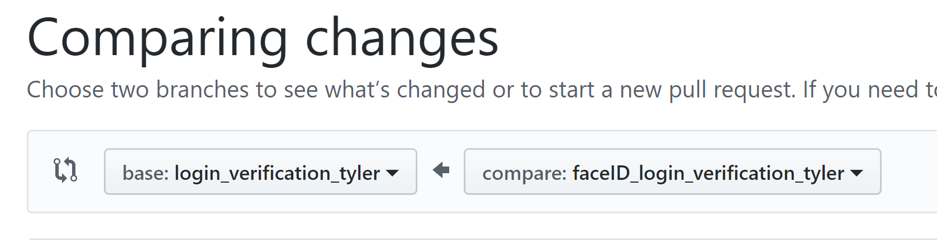
Merging Changes into parent branch
These types of merge is when you feel like this part of the feature is done.
NEVER push broken code to master.
Create pull request but do not automatically merge into master.
Delete your branch when you are certain the changes you want are included in the parent branch.

Slide 6
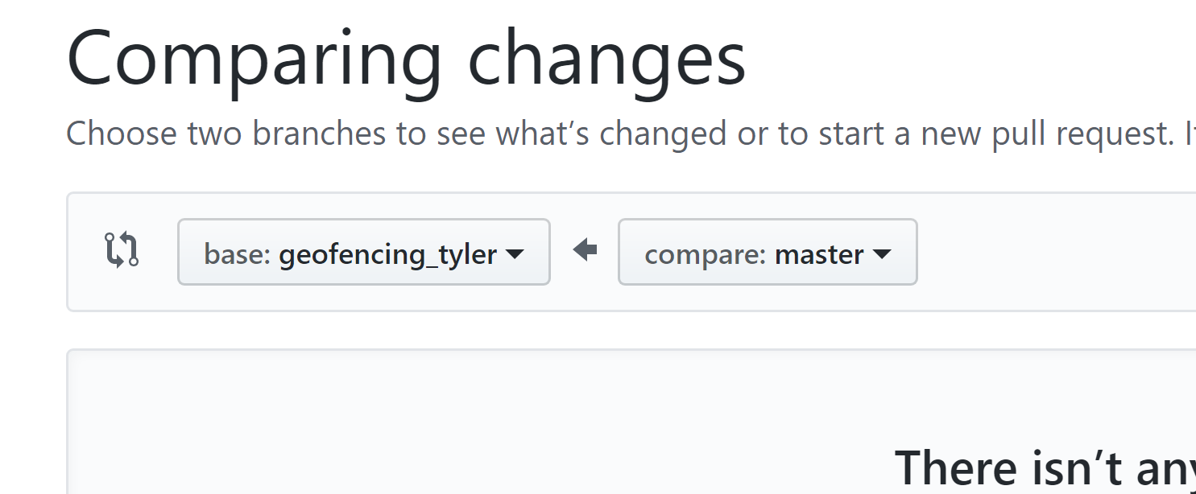
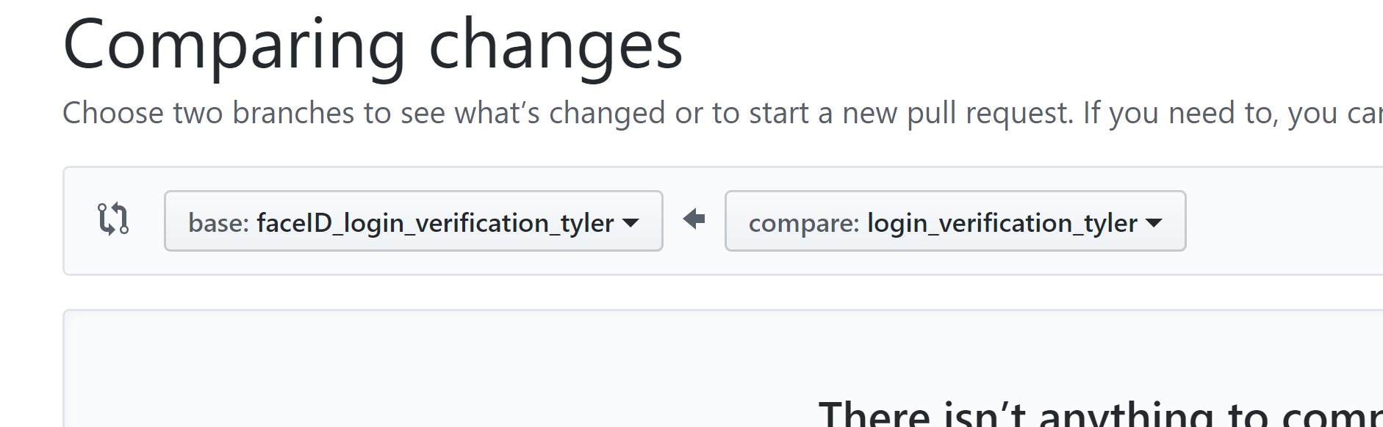
Updating your child branch
These types of merges are if you are working on a feature, but the parent branch made an update.
Merge the changes from the parent branch into your branch.
DO NOT DELETE THE PARENT BRANCH

Slide 7
When in doubt save everything locally

